Slide 1
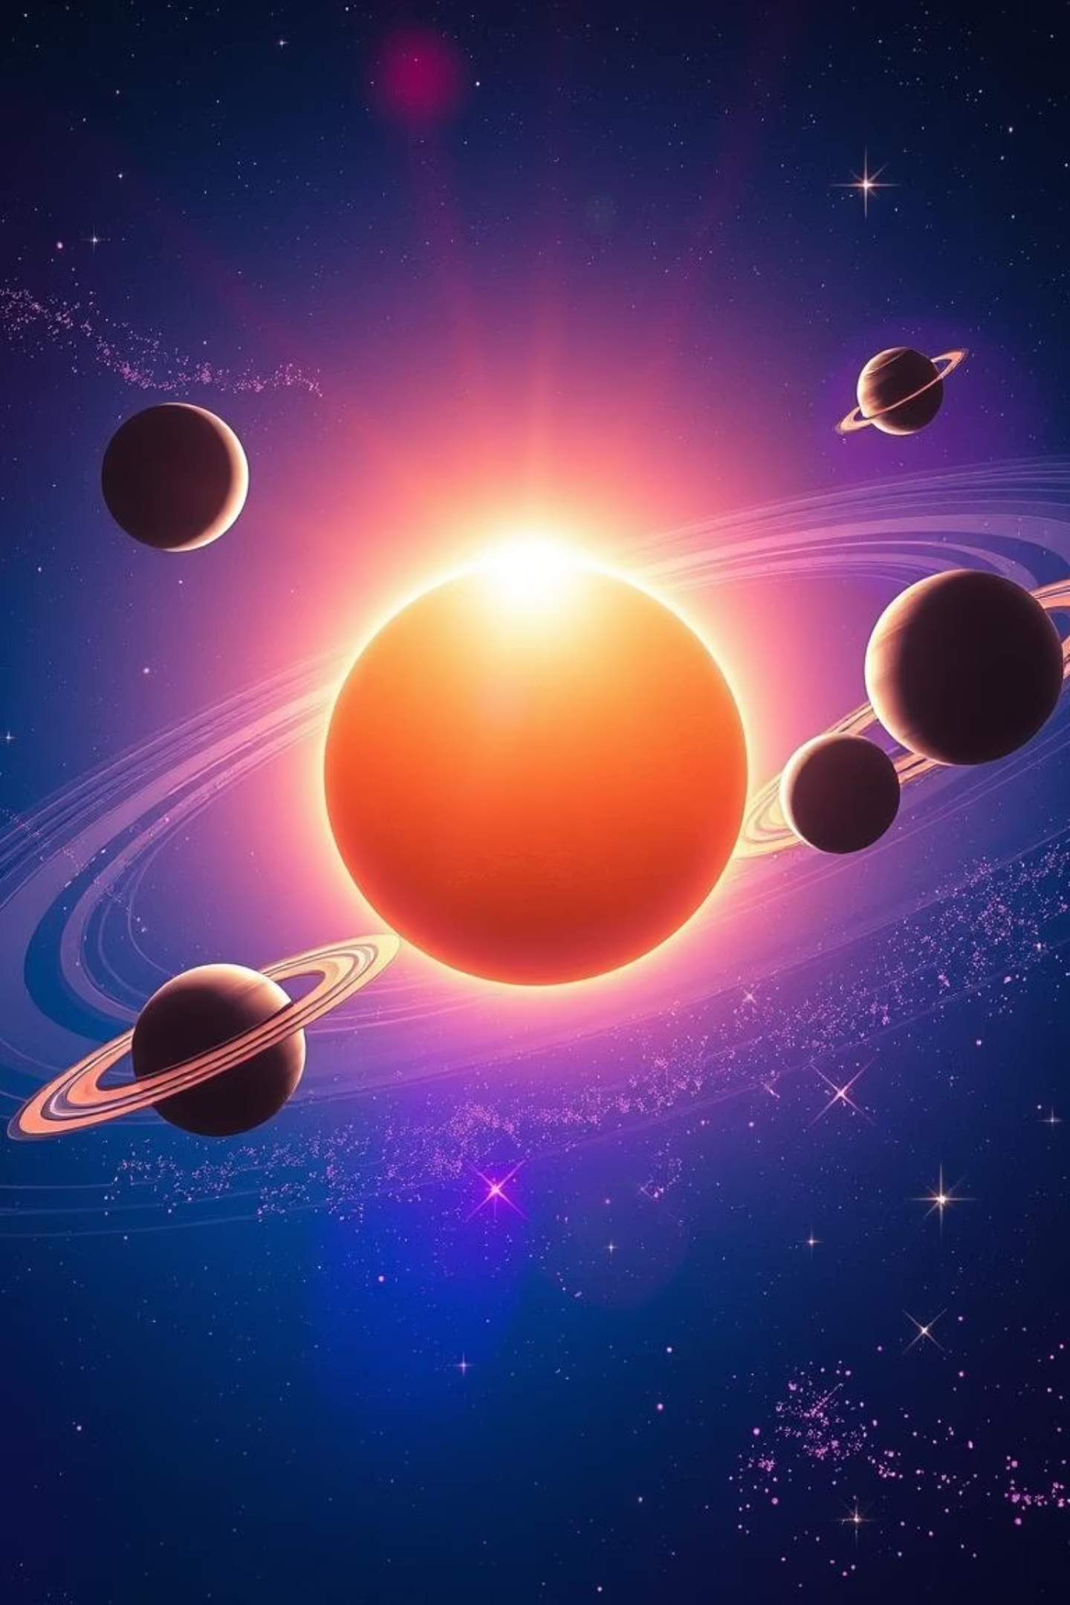
The Solar System
An Easy & Fun Guide to Our Cosmic Neighborhood!

Slide 2
What is the Solar System?
Cosmic Family
Ancient Origins
Sun's Dominance
Made up of the Sun and all objects orbiting it, including planets, moons, asteroids, comets, and meteoroids.
Formed 4.6 billion years ago from a giant cloud of gas and dust.
Fun Fact: The Sun makes up 99.8% of the Solar System's mass!

Slide 3
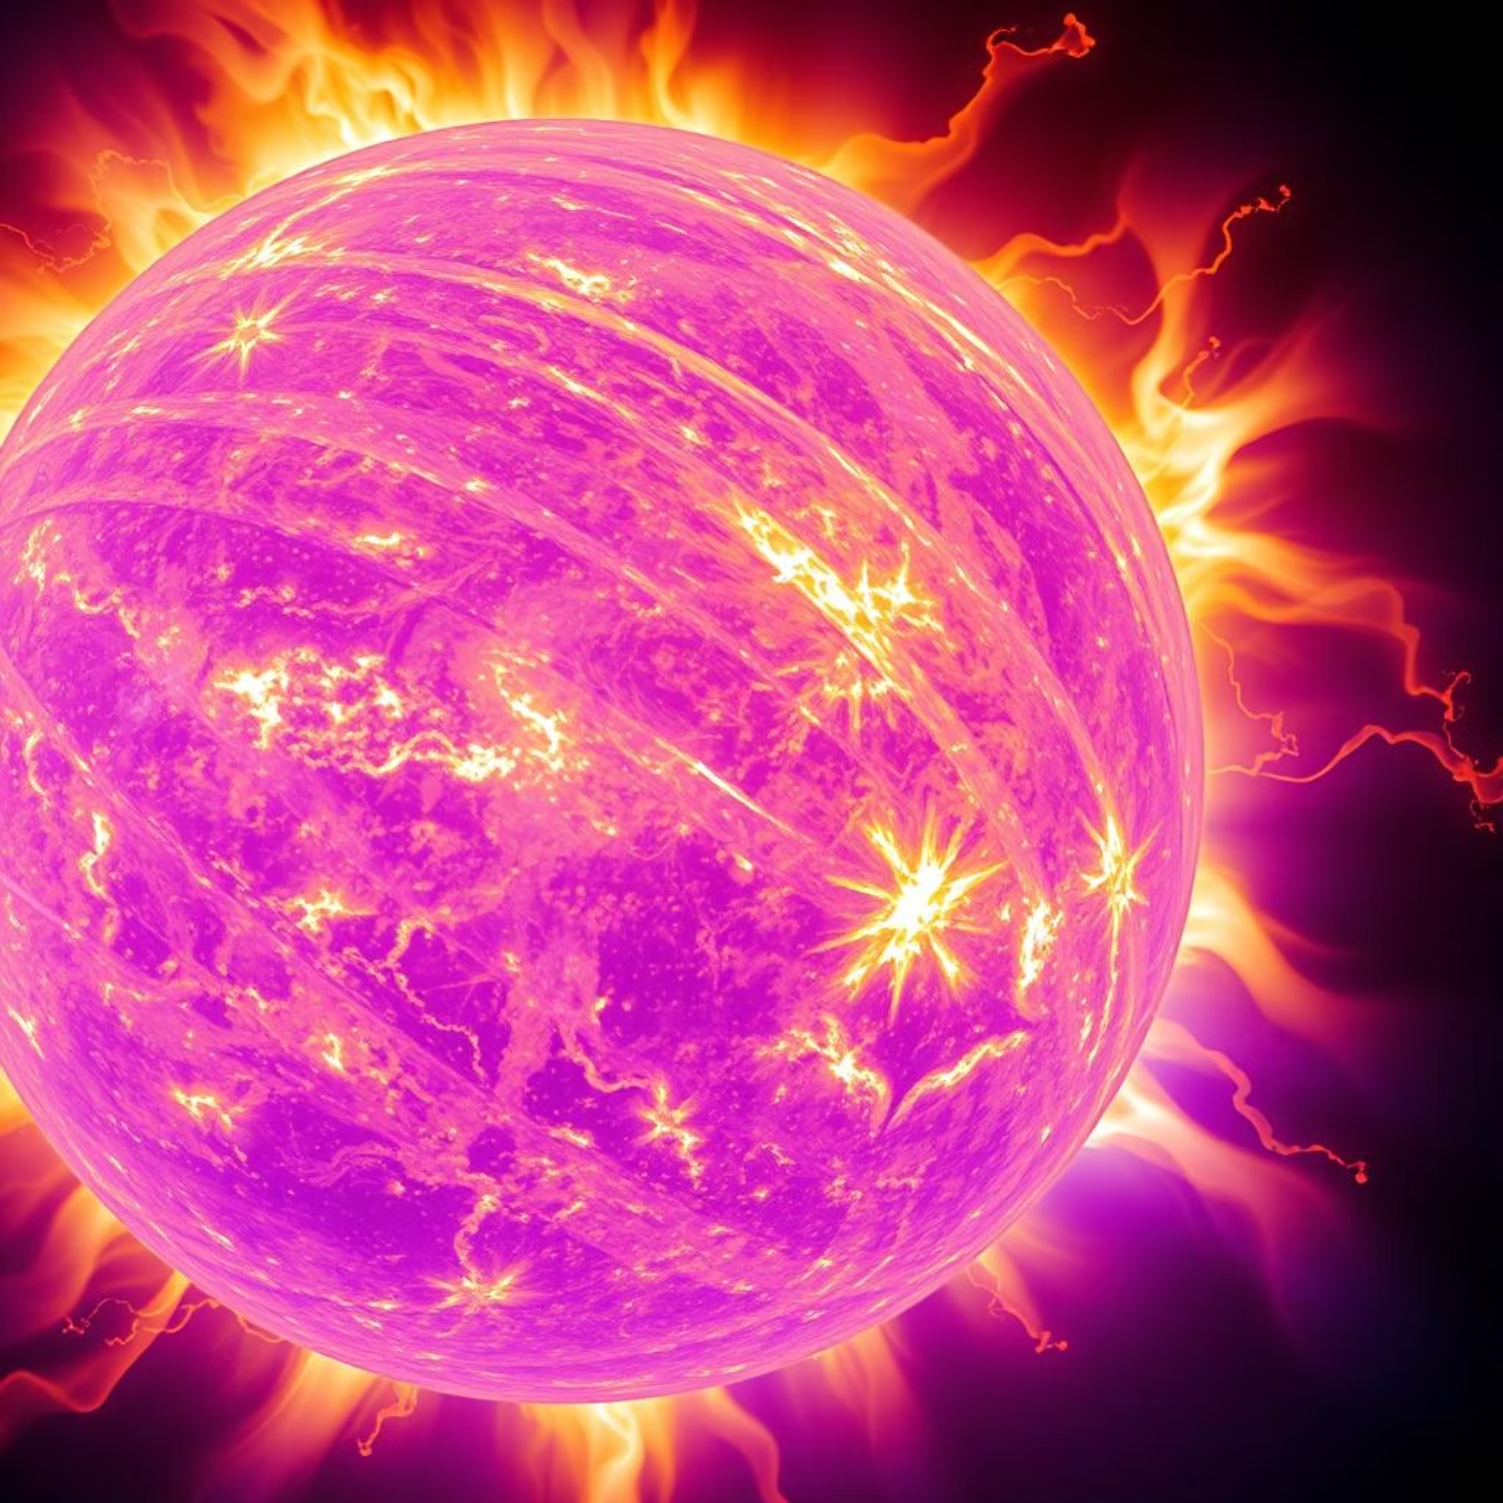
The Sun: Our Star
Giant Ball of Gas
A huge ball of hot, glowing gases, primarily hydrogen and helium.
Life-Giving Energy
Provides light, heat, and energy essential for all planets.
Extreme Heat
Surface temperature reaches about 5,500°C!

Slide 4
The 8 Planets: Rocky Worlds
Order from the Sun: My Very Educated Mother Just Served Us Noodles
Mercury
Rocky
Fastest planet (88-day year)
Venus
Rocky
Hottest planet (thick CO₂ atmosphere)
Earth
Rocky
Only planet with life!
Mars
Rocky
Called the "Red Planet" (iron oxide)

Slide 5
The 8 Planets: Gas & Ice Giants
Jupiter
Gas Giant
Largest planet (Great Red Spot storm)
Saturn
Gas Giant
Beautiful rings (made of ice & rock)
Uranus
Ice Giant
Rotates sideways! ♅
Neptune
Ice Giant
Windiest planet (2,100 km/h winds!)
Bonus: Pluto is now a dwarf planet!

Slide 6



Other Cosmic Neighbors
Moons
Asteroids
Natural satellites orbiting planets (Earth has 1, Jupiter has 95+!).
Rocky objects, mostly found in the Asteroid Belt.
Comets
Meteoroids
"Dirty snowballs" with glowing tails (e.g., Halley's Comet).
Small rocks that burn up as "shooting stars."

Slide 7
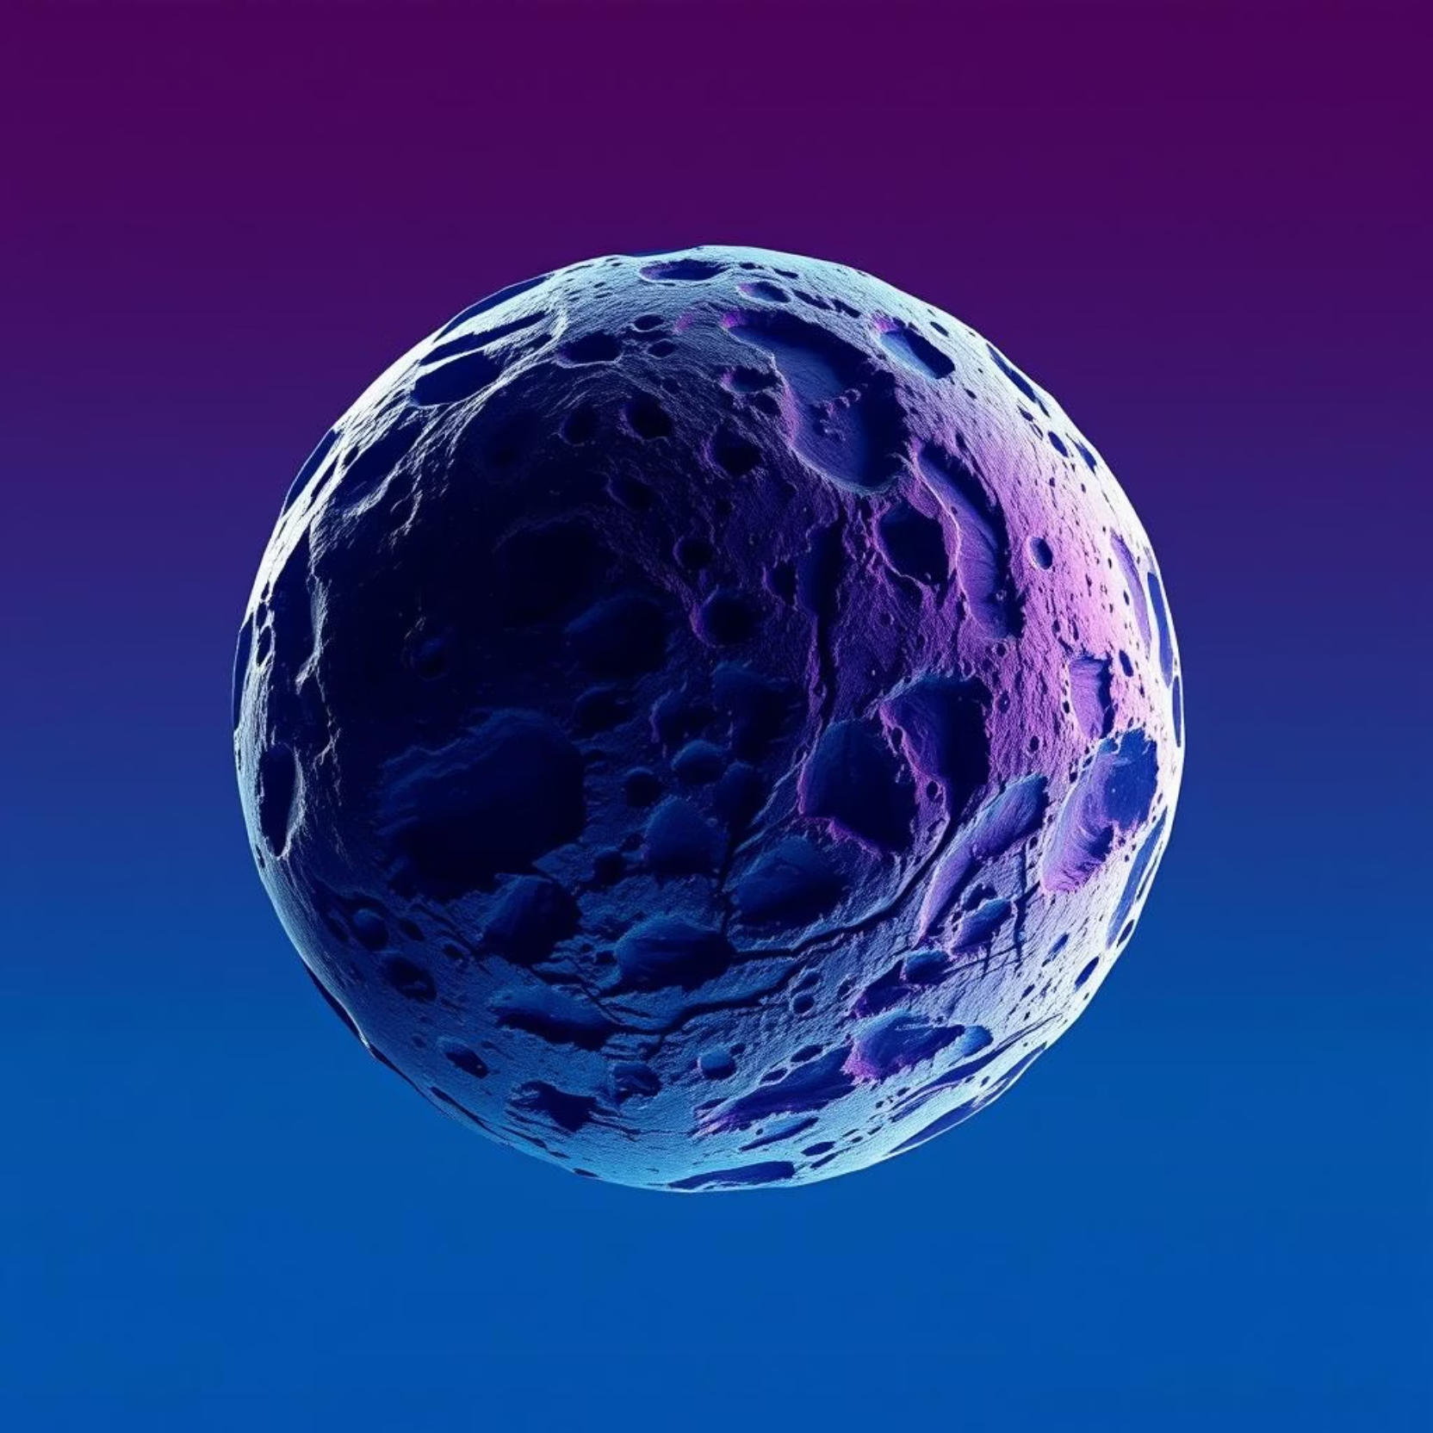
Ceres: The Dwarf Planet Asteroid
☄️ Did You Know? The biggest asteroid, Ceres, is also a dwarf planet!
Ceres is the largest object in the asteroid belt between Mars and Jupiter, making it unique as both an asteroid and a dwarf planet.
Its classification as a dwarf planet highlights its significant size and hydrothermal activity, setting it apart from other asteroids.

Slide 8
Why Earth is Special
Liquid Water
Protective Atmosphere
Perfect Distance
Has abundant liquid water in oceans and rivers, crucial for life.
Features an atmosphere rich in oxygen, vital for breathing.
Located at the ideal distance from the Sun – not too hot or too cold.

Slide 9
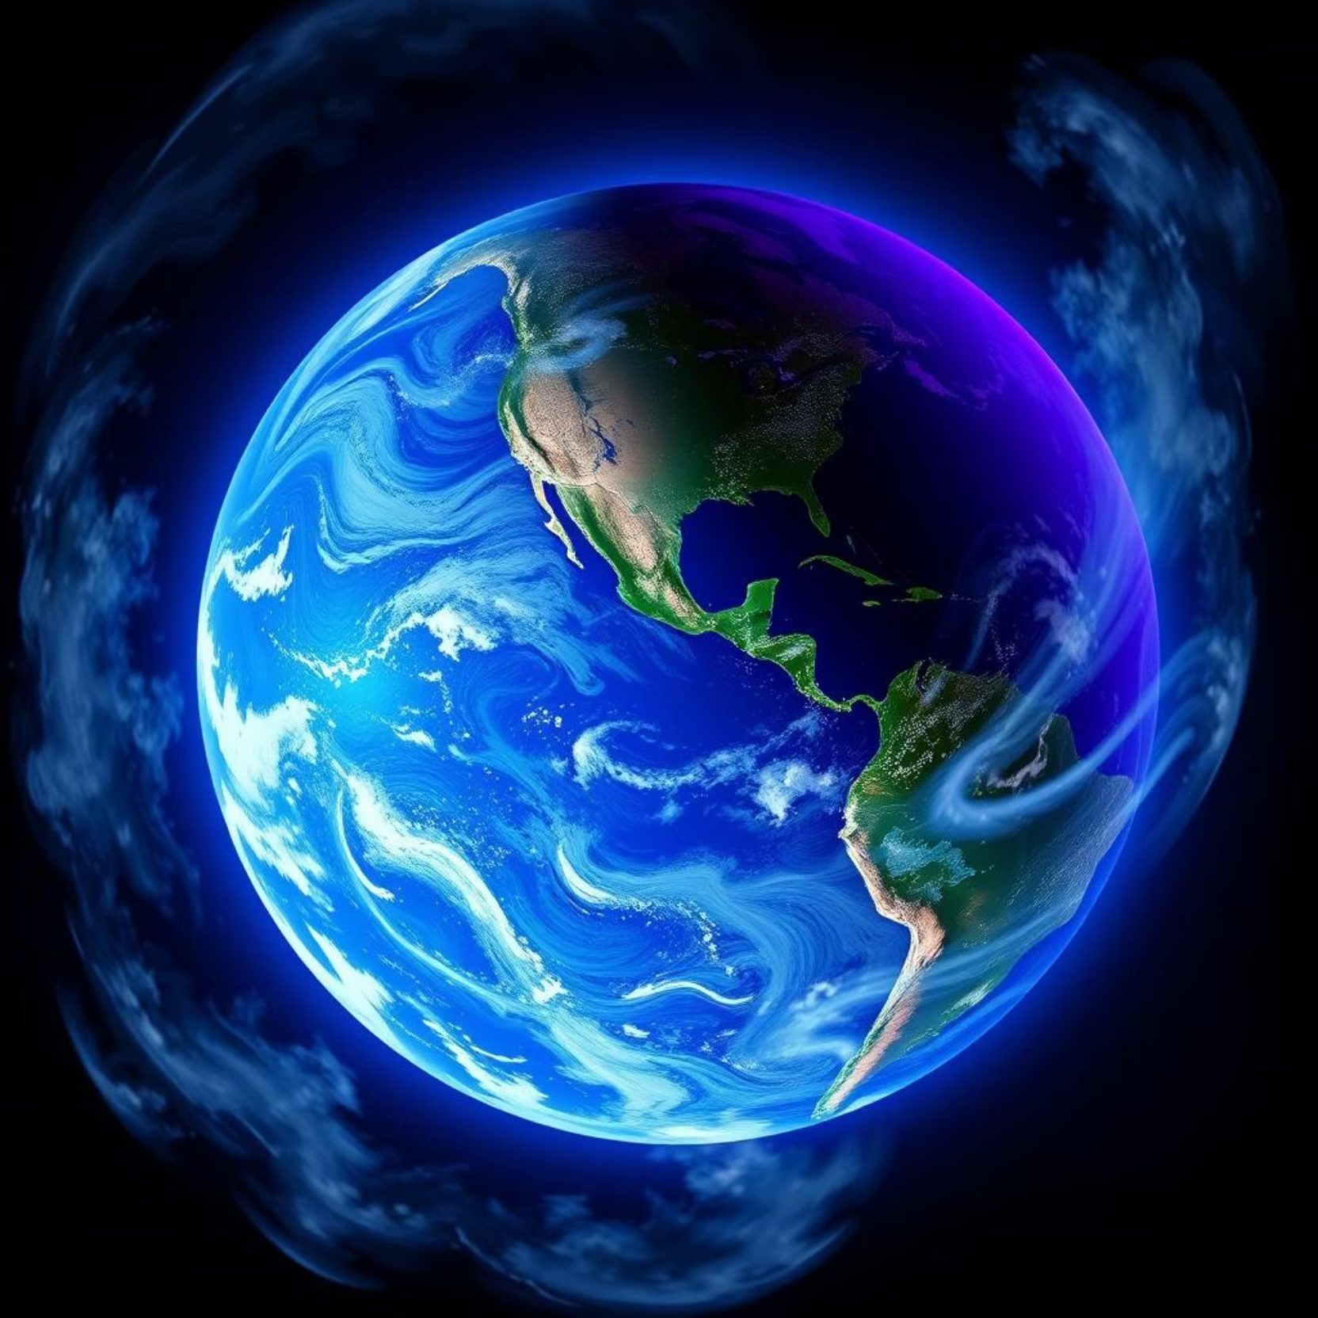
Earth's Unique Conditions
Earth's unique combination of liquid water, a breathable atmosphere, and its optimal distance from the Sun creates the perfect conditions for life to thrive.
These factors allow for a stable climate and diverse ecosystems, making our planet truly exceptional in the Solar System.

Slide 10
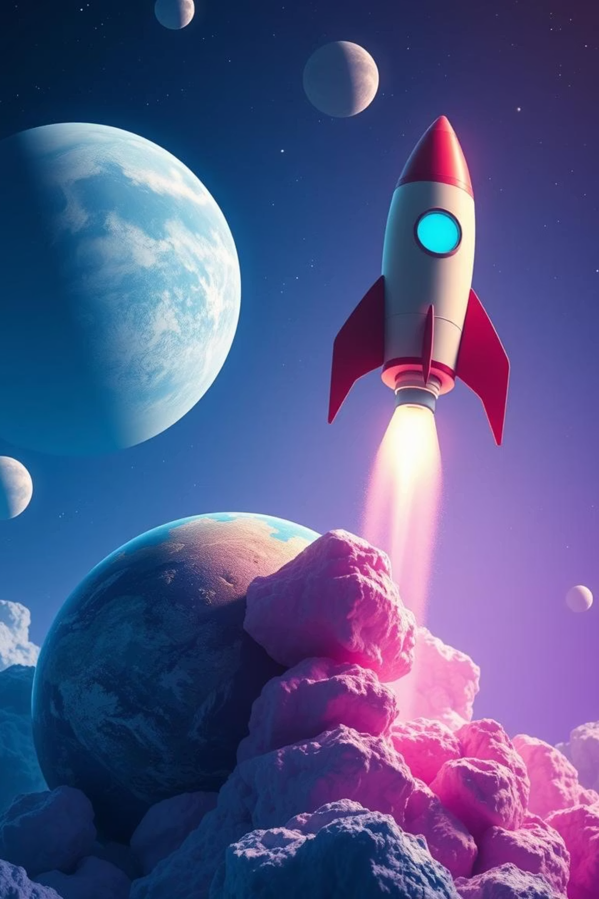
Explore Our Cosmic Home!
The Solar System is a fascinating place, full of wonders from the fiery Sun to distant ice giants and tiny meteoroids.
Keep exploring and learning about our incredible cosmic neighborhood! 🚀

